Slide 1
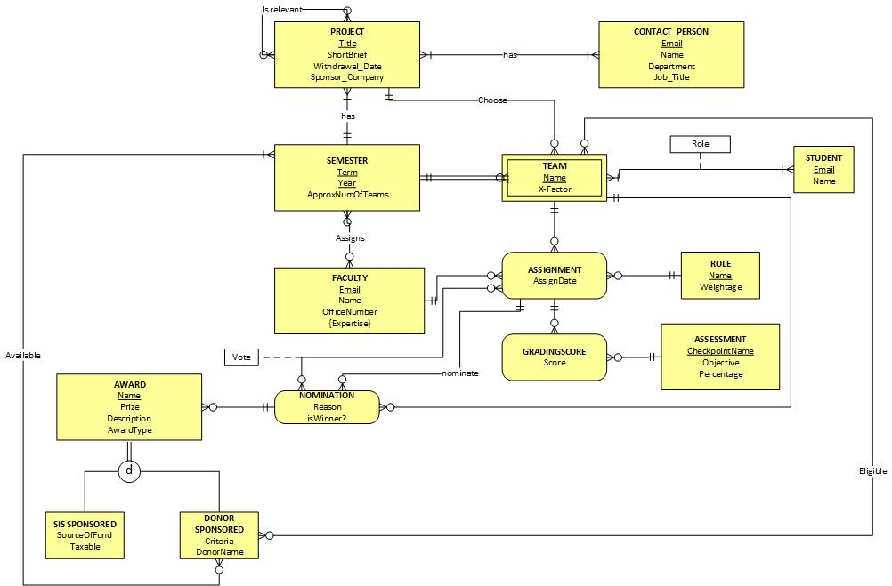

Slide 2
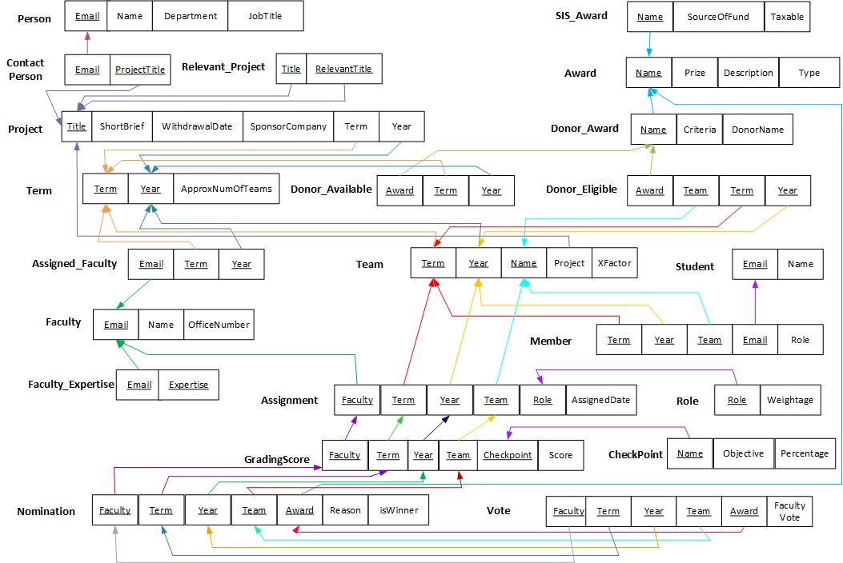

Slide 3

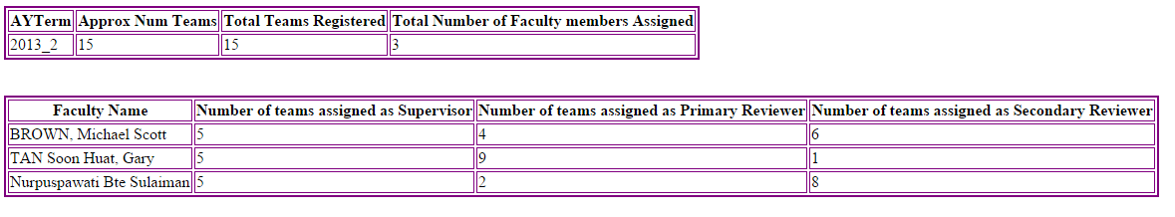
Report 1 : Term
Query
Result

Slide 4

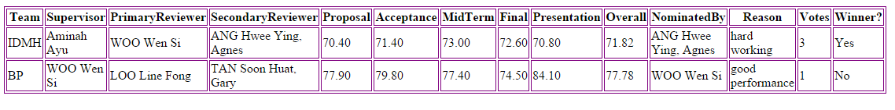
Report 2 : Award and Term
Query
Result

Slide 5

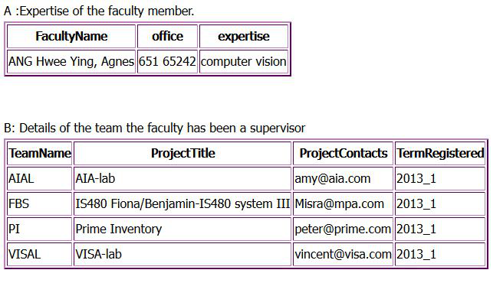
Report 3 : Faculty
Query
Result

Slide 6
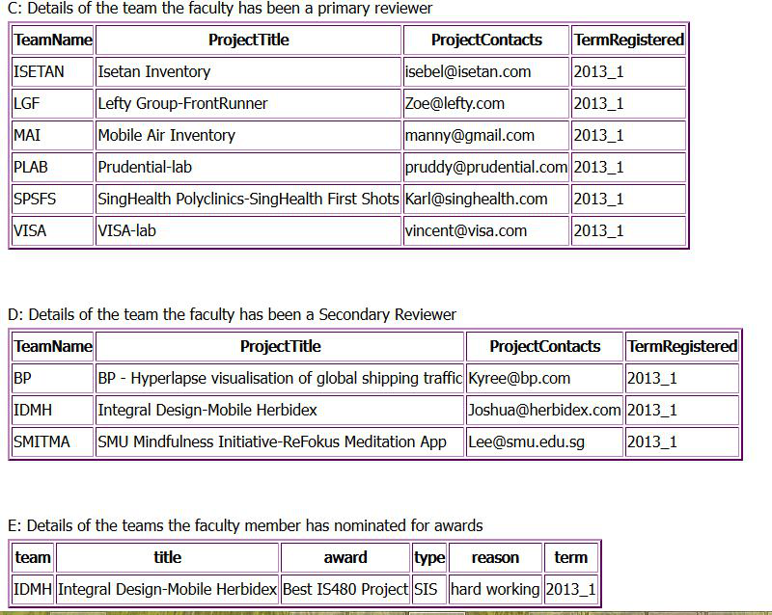
Report 3 : Faculty
Query
Result

